Slide 1
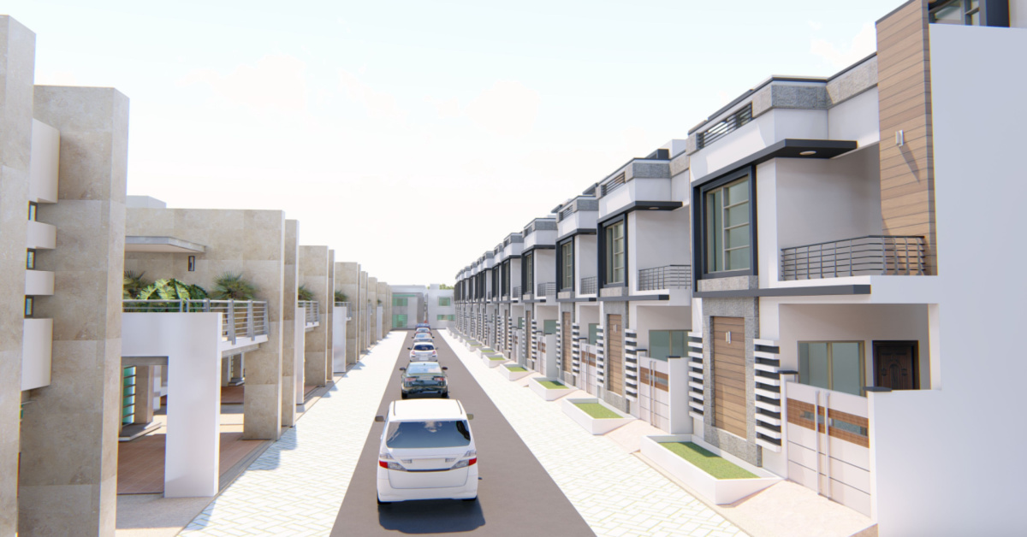
Demand Generation Plan
“Harmony Hills Homes Project”
Created By: Rakesh Jatolia

Slide 2

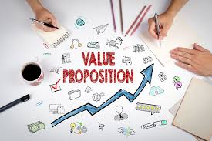

Harmony Hills Homes(Hypothetical)
Conveniently located near the Jaipur-Gurugram Highway, offering 3BHK, 4BHK, and 5BHK homes, providing a peaceful environment with easy access to urban amenities.
Ideal for families seeking a harmonious blend of comfort, tranquillity, and modern living.
Includes clubs, gym, parks, schools, and shopping options, catering to family-centric lifestyles.
Purpose: To outline a strategic lead generation plan designed to drive walk-ins and conversions for "Harmony Hills Homes."

Slide 3
Sections
1 | Understanding Our Target Audience
2 | Demand Generation Strategies
3 | Lead Tracking and Analytics

Slide 4

01
Understanding Our Target Audience

Slide 5

Demographics & Age: Our target audience primarily consists of families and individuals seeking a tranquil residential environment near Gurugram. They are typically professionals or families looking to relocate to a serene yet accessible location Primarily adults in the age range of 30-55 years.
Preferences: They prioritize spacious living spaces, including 3BHK, 4BHK, and 5BHK homes, equipped with modern amenities such as club facilities, gyms, and recreational areas. Proximity to quality schools and convenient access to shopping centres are key considerations.
Psychographics: Our audience values a balanced lifestyle, emphasizing community engagement and access to facilities that cater to both adults and children. They seek a harmonious blend of urban conveniences and peaceful living.

Slide 6

02
Demand Generation Strategies

Slide 7
Sales Funnel
Marketing campaign and market research
Digital/Social Maketing, SEO opt., PPC,
Email, Webinar, Virtual Presentation of the project
Referral Program & Incentives
Client Relation building, Site visits
Lead nurture
Sales & marketing work to prove their property is best
Purchase : Sales transaction is complete

Slide 8
Integration of No-Broker Platform and External Marketing Activities
No-Broker Platform:
Listing Optimization: Ensure "Harmony Hills Homes" is prominently listed with detailed information, high-quality images, & accurate pricing on No-Broker site .
Lead Management: Use No-Broker's tools for lead management, tracking, and engagement to effectively convert leads into site visits and conversions.
External Marketing Activities
Digital Marketing: Continue with SEO, PPC advertising, social media marketing, and content marketing strategies as discussed earlier.
Email Marketing: Implement lead nurturing campaigns that integrate leads generated from external sources with those from No-Broker.
Events and Webinars: Host virtual events and webinars to engage potential buyers outside of the No-Broker platform.
Webinar or Virtual Event Launch Strategy
Event Schedule:
Set a consistent schedule (e.g., every week or bi-weekly) for hosting webinars or launch events.
Plan event topics and content variations to keep each session informative and engaging.
Audience Engagement:
Promote each event through targeted marketing campaigns to attract new attendees and returning participants.
Use social media, email marketing, and direct invitations to reach a broader audience and encourage registration.
Follow-up and Conversion:
Implement a structured follow-up process after each event to nurture leads and schedule personalized site visits or virtual tours.
Continuously track attendee engagement and adjust follow-up strategies based on attendee feedback and interest levels.
Iterative Optimization:
Regularly review event analytics, attendee feedback, and conversion rates to optimize event content, promotion strategies, and follow-up tactics.

Slide 9
Lead Conversion Strategy
Lead Nurturing Process:
Outline the steps from initial lead capture to converting leads into walk-ins and sales.
Define how Relationship Managers will engage with leads, including follow-up communication, virtual or physical site visits, and addressing buyer inquiries promptly.
Personalized Engagement:
Implement personalized communication strategies tailored to the needs and preferences of potential buyers.
Use CRM tools to track interactions, preferences, and readiness to purchase.
Offer Incentives and Special Promotions:
Consider offering exclusive incentives or limited-time promotions to encourage leads to schedule site visits or make purchasing decisions.
Communicate these offers effectively through all marketing channels.
Feedback and Continuous Improvement:
Gather feedback from leads and Relationship Managers to continuously improve the lead conversion process.
Analyze conversion rates and adjust strategies based on performance data.

Slide 10
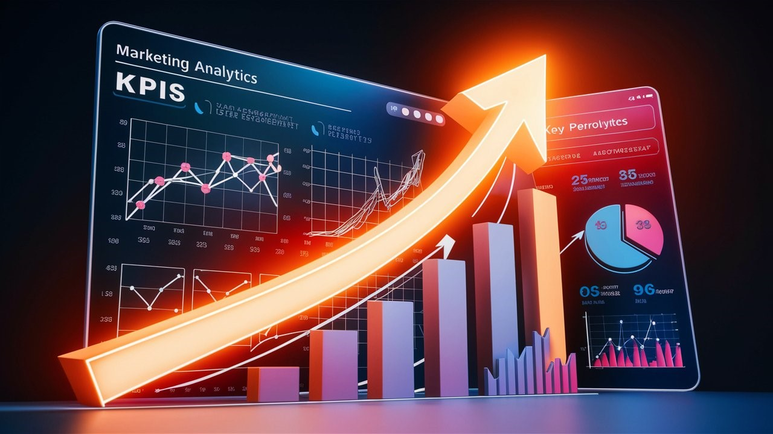
03
Lead Tracking and Analytics

Slide 11
Key Metrics and KPIs
Lead Generation Metrics:
Leads Generated: Track the total number of leads generated from both No-Broker platform and external marketing channels.
Lead Quality: Assess the quality of leads based on criteria such as completeness of information, engagement level, and readiness to buy.
Conversion Rates:
Lead-to-Walk-in Conversion Rate: Measure the percentage of leads who convert into scheduled site visits or attend virtual tours.
Walk-in-to-Sale Conversion Rate: Track the percentage of site visits or virtual attendees who eventually purchase a property.
ROI and Cost per Acquisition (CPA):
ROI: Calculate the return on investment from your marketing and promotional activities, considering the costs incurred versus revenue generated.
CPA: Determine the cost per acquisition by dividing total marketing expenses by the number of properties sold or conversions achieved.
Event and Webinar Engagement:
Attendee Engagement: Monitor attendance rates, participant interactions (questions asked, polls participated in), and feedback from attendees.
Conversion from Events: Measure the number of leads converted into site visits or sales directly attributable to webinar or event participation.
Tools and Systems
CRM Integration: Use a robust CRM system to centralize lead management, track interactions, and monitor conversion pipelines.
Analytics Platforms: Utilize analytics tools like Google Analytics, social media insights, and email marketing analytics to gather data on campaign performance.

Slide 12
Implementation Steps
Weekly Reporting: Generate concise weekly reports summarizing key metrics, performance trends, and actionable insights.
Strategy Meetings: Conduct regular meetings with your team to discuss findings, brainstorm new ideas, and prioritize optimization efforts.
Iterative Testing: Implement A/B testing for different promotional messages, visuals, or audience segments to continuously improve campaign effectiveness.
Benefits of Weekly Monitoring
Agility: Enables quick adjustments to campaigns based on real-time data and market feedback.
Efficiency: Maximizes ROI by focusing resources on the most effective promotional strategies.
Continuous Improvement: Facilitates a culture of continuous learning and adaptation to enhance overall marketing performance.

Slide 13
Thanks!

